Slide 1
Deep Learning
© Templateswise.com
INFS-6720-B – Data Mining
Presented By: Nistha Baxi

Slide 2
Index
Deep Learning Introduction
Deep Learning Architecture
Types of Deep Learning
Convolutional Neural Network Introduction
Project
References

Slide 3
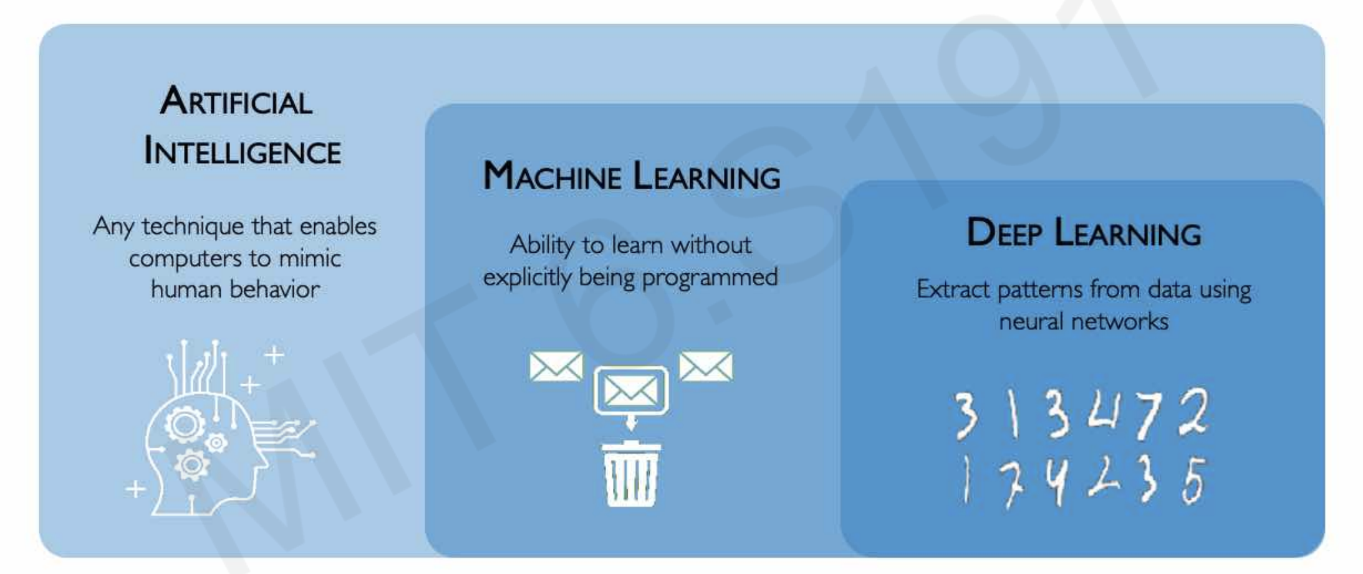
AI vs ML vs DL

Slide 4
Deep Learning
A machine learning method that allows computers to learn like the human brain to analyze data on their own
Uses multiple network layers for making predictions and learning complex patterns
Neural network is a series of layers that takes the input, processes from layer to layer, and finally generates the output/result
Reasons to use deep learning
Handles unstructured data well once model is trained on structured data
Provides accurate results in audio processing, NLP
Well suited for pattern recognitions

Slide 5
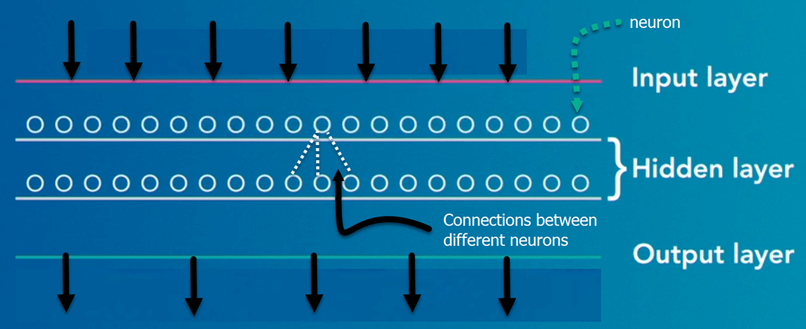
How Deep Learning works
Input layer takes data and forward it to hidden layer.
Hidden layers are consisting of neurons and each neuron receives information from source. Connection between neurons is called weight. It indicates how much influence the input will have on output. This is the layer where all the processing happens.
Output layer selects the highest predictable label.

Slide 6
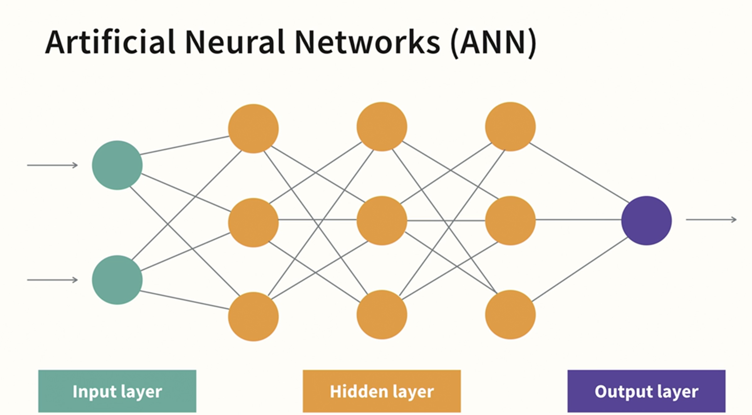
Types of Deep Learning
Artificial Neural Network(ANN)
Data is fed into input layer then calculated and extracted by hidden layers and the last output layer makes decision based on information simplified by previous layer.
Regular ANN does not work so well with NLP and Image processing task.

Slide 7
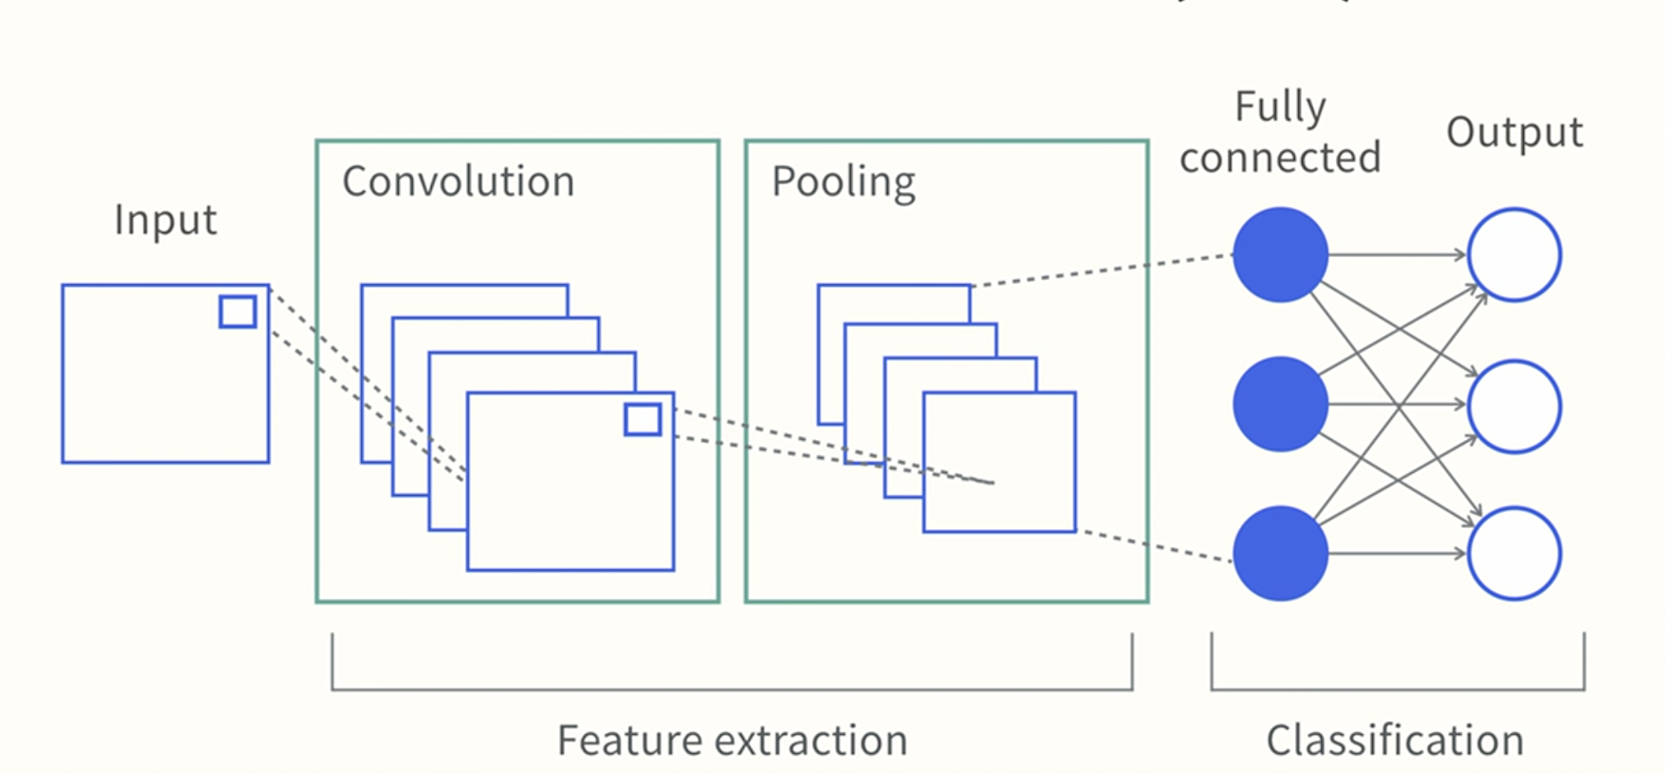
Convolutional Neural Network(CNN)
Focuses more on the feature of the data.
The unique layers of CNN are convolutional and pooling layer which are used to find the important feature and drop the not so relevant feature of data.

Slide 8
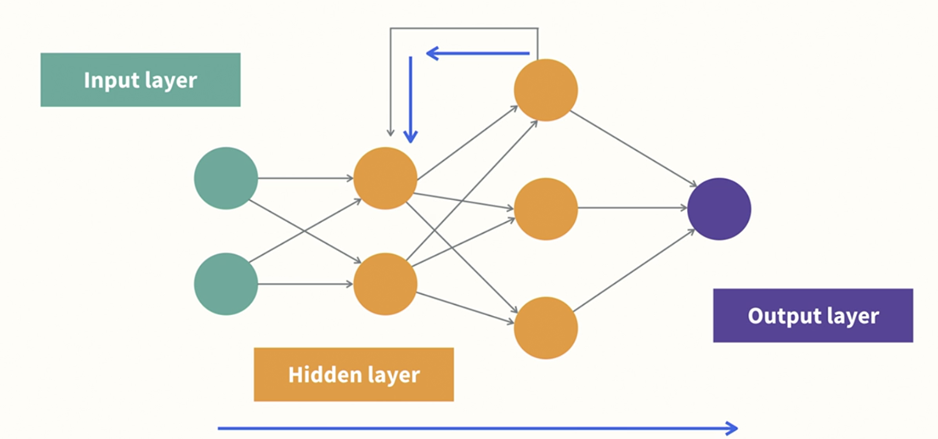
Recurrent Neural Network(RNN)
Passes data forward and backwards, meaning it remembers the context before and after the current word in a sentence.
Well suited for sequential data like text and audio.

Slide 9
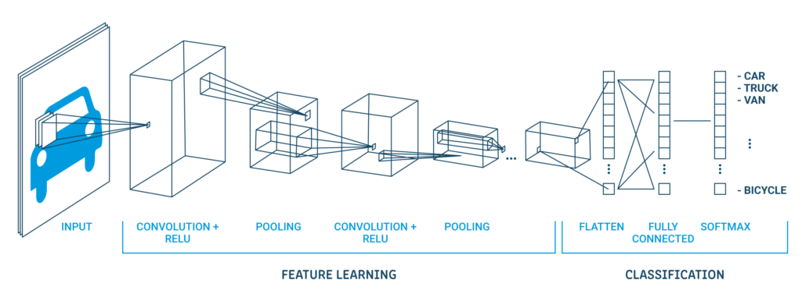
Convolutional Neural Network
Convolutional neural network (CNN): CNN is mostly used to analyze visual images (Image processing). It is a multi-layered neural network which is designed detect and classify objects in an image. Most common applications are face recognition, autonomous cars (detects the objects on the road).
To illustrate, CNN gets an image of a car (collection of pixels).
During the feature learning (hidden layers), the network will identify unique objects like tires, doors.
Once network has completely learned to recognize the image, it provides the probability for each image it knows. The highest probability image will be the prediction.

Slide 10
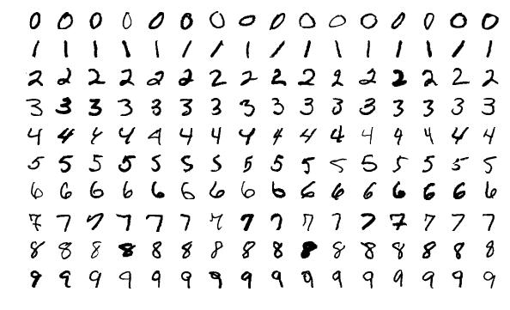
CNN Project
Objective - To classify handwritten number images
Dataset
For the project purpose, I am using the dataset MNIST.
It contains 60,000 images of numbers ranging from 0-9 under training and 10,000 images under testing.
Each image size is 28x28 pixels. The images looks like this.

Slide 11
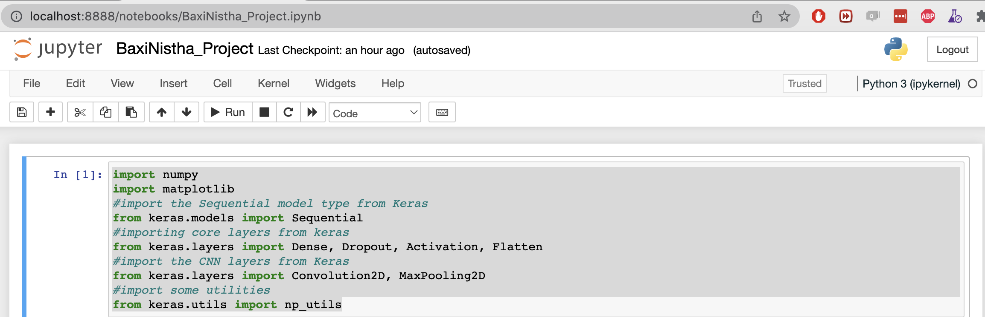
Installations
Programming Language – Python
Libraries – Keras, NumPy, TensorFlow
Import libraries and modules
Import numpy and matplotlib
Import sequential model type from Keras
Import “core” layers that are used in any neural network – Dense, Dropout, Activation, Flatten
Import CNN layers from Keras – Help us efficiently train on image data – Convolution2D, MaxPooling2D
Import utilities – help us transform the data later

Slide 12
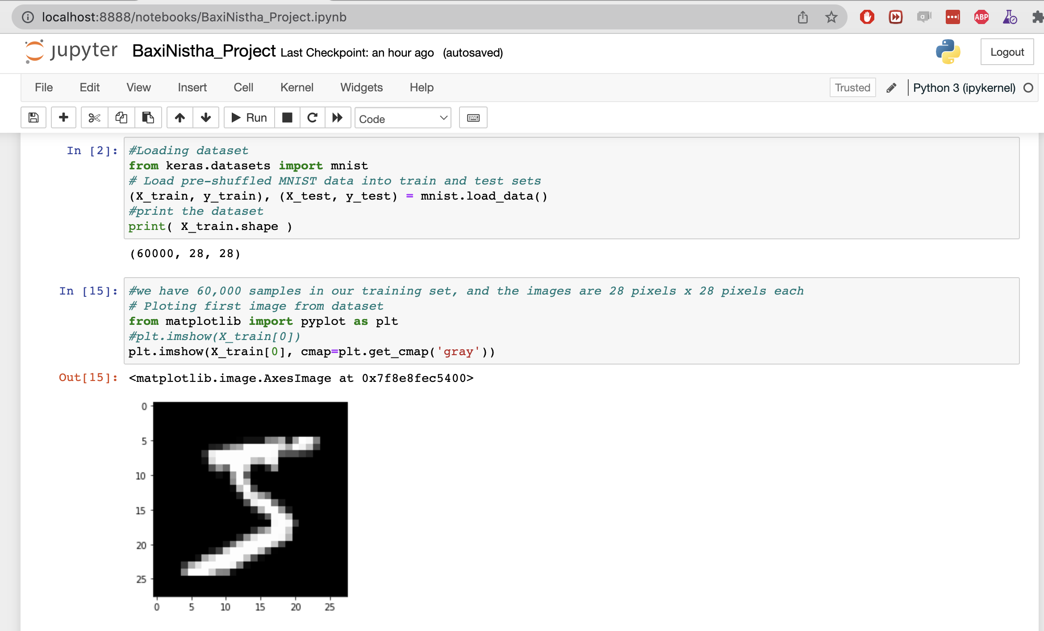
Load image data from dataset (MNIST)
Load the MNIST dataset (Keras already has MNIST data)
To look at the shape of the dataset, where 60000 is the number of samples (images) in the training dataset, and each image is 28x28 pixels.

Slide 13
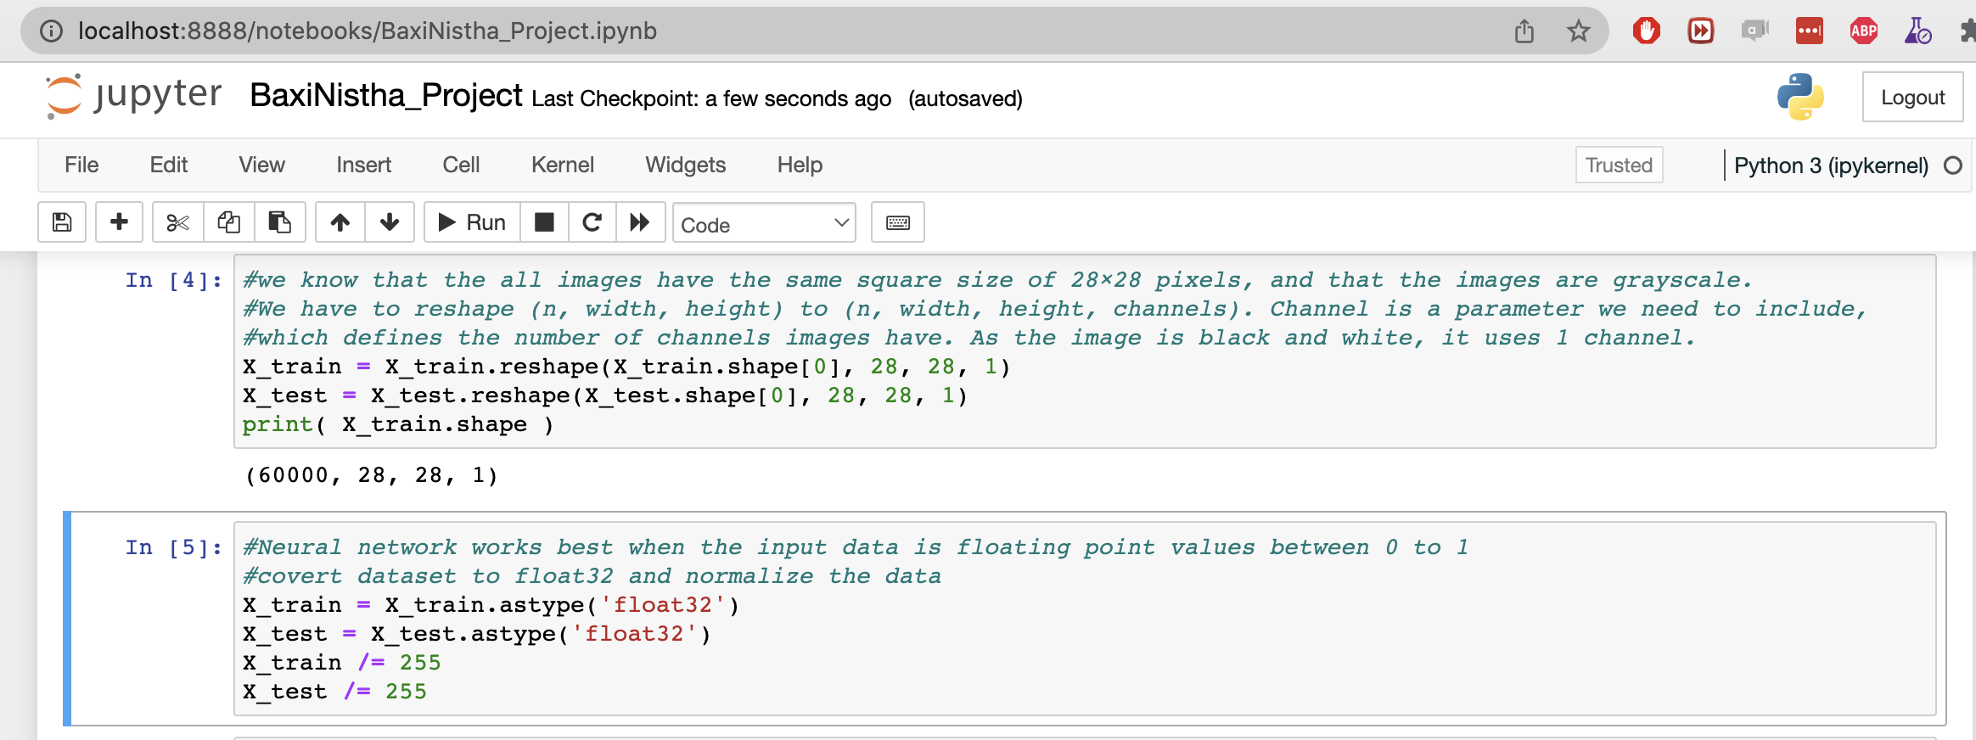
Prepare the input data for Keras

Slide 14
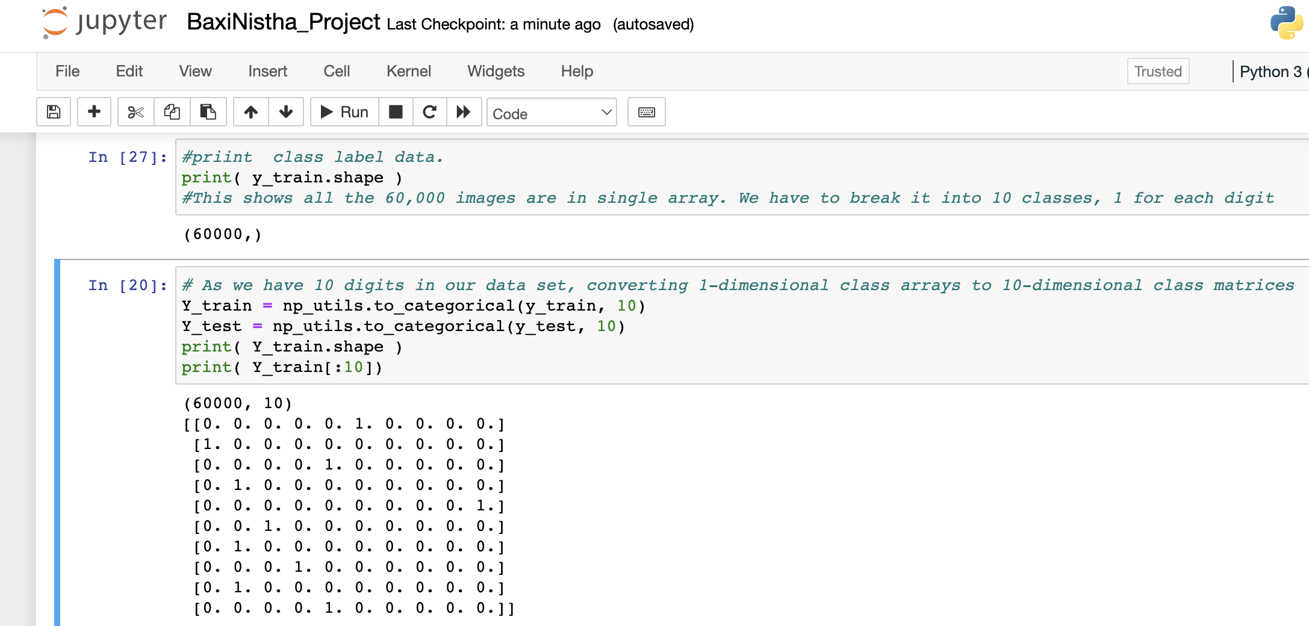
Preprocess class labels
Labels are nothing but the names that defines the image. As we have target variable with 10 different classes, We will create target encoding for output variable. This means that a column will be created for each output category and convert it into binary.

Slide 15
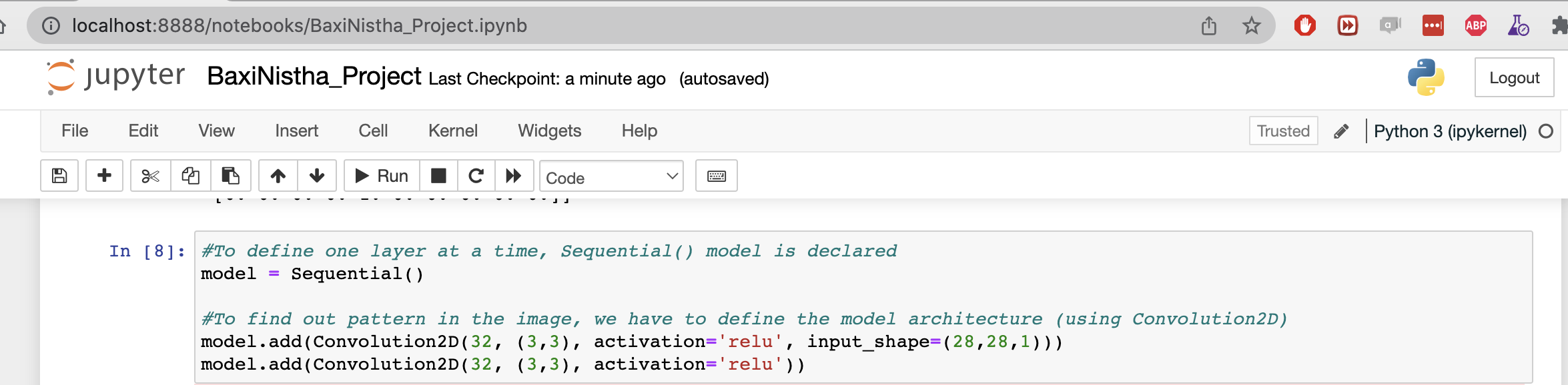
Building model architecture
Images are 2D, that is the reason we are using Convolution2D ().
First parameter is the number of filters in each layer. Each filter is capable of detecting one pattern in the image
Second parameter is the size of pixels in which we need to split the image.
Third parameter is the activation function to be used
Forth parameter is the input_shape (size of image in pixels, number of channel)
To make the network model more powerful, 2nd Convolution2D model is added.

Slide 16
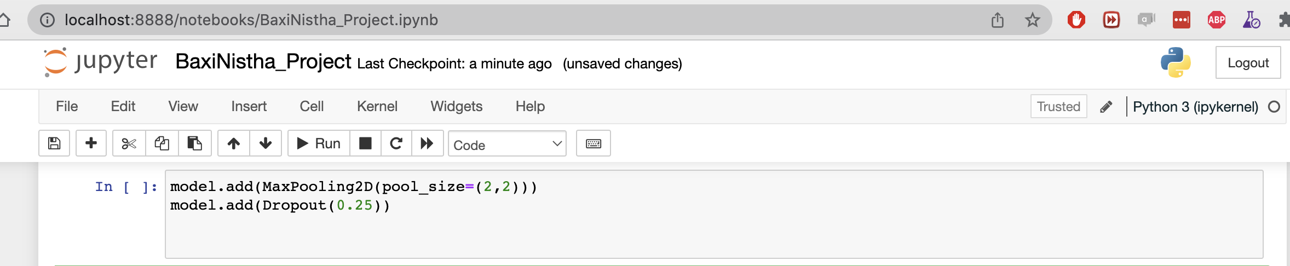
MaxPooling and Dropout()
MaxPooling2D is a function that scales down the output of convolutional layer by keeping only the largest values. It takes only single parameter of pool size = (pixel, pixel) - It divides the image in given pool size squares and take only the largest value from the pool_size region.
Dropout() – Neuron networks memorize the input data instead of learning. This limitation can cause the overfitting situation. This function overcomes the problem by randomly removing the connections between the layers. Ideal range for dropout is 0.25 – 0.5.

Slide 17
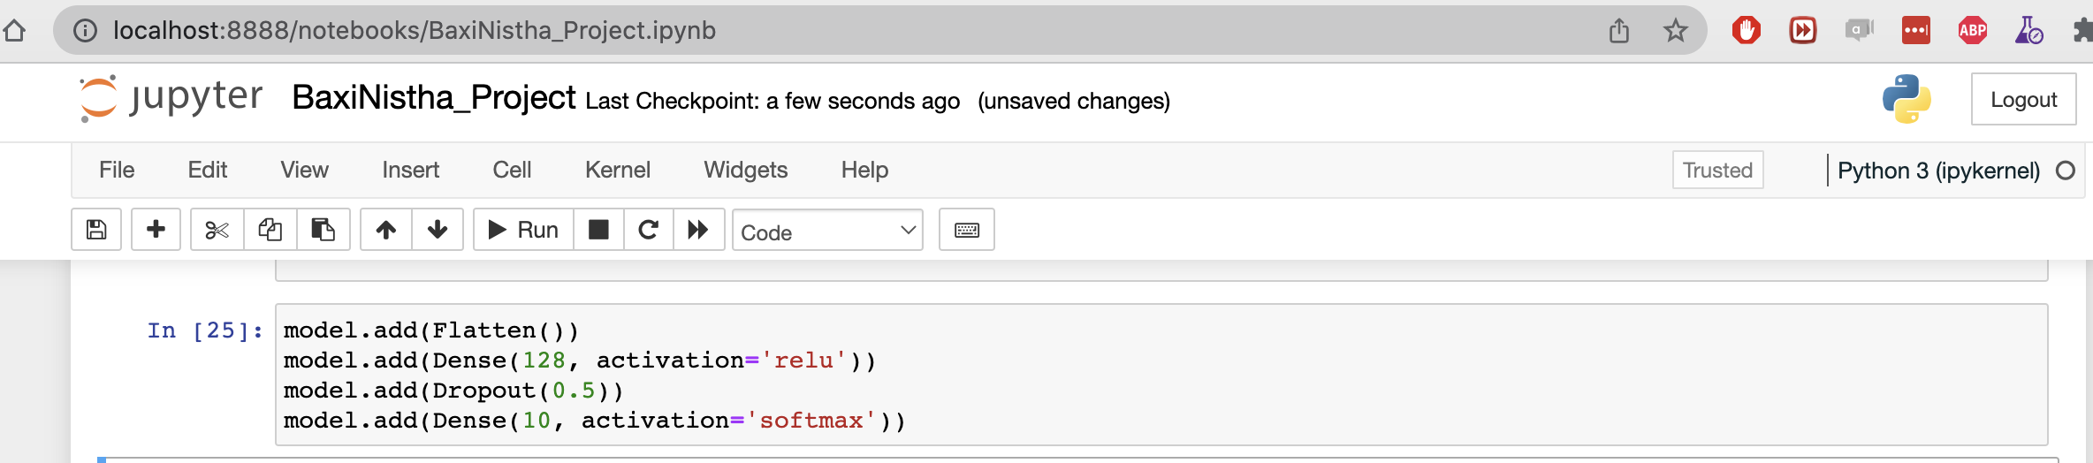
Fully connected layers
Flatten() – Whenever we transition between convolutional and dense layers, we have to update Keras saying we’re not working on 2D data. To convey this, flatten() is used.
Dense() – Dense layer works with the converted 1D data. Actual classification work will be done by dense layer. 128 is the number of nodes we are adding.
Dense() output layer – we need one node in the output layer for each class. As we have total 10 classes, the number of neuron in output is also 10. Softmax activation is used when we have 2 or more than 2 classes in output layer.

Slide 18
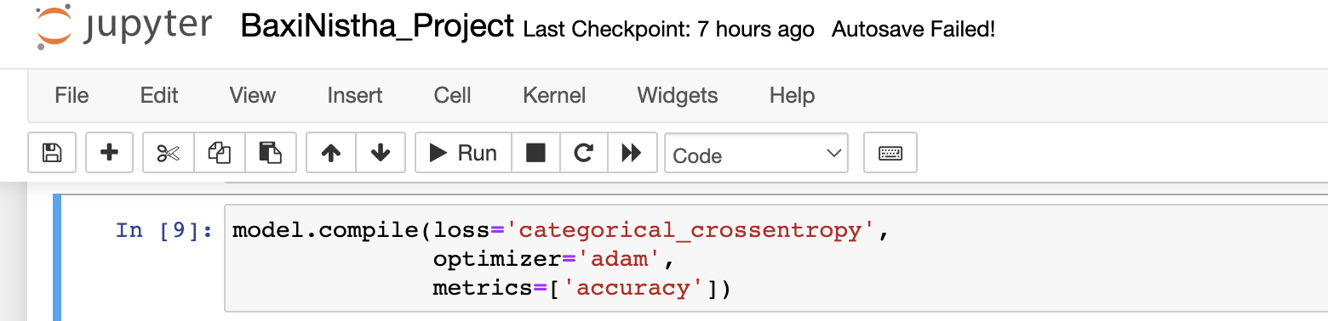
Compile model
Once we are done defining the model of our neural network, we have to check for potential errors in the model. Compile is the process to check that and tell system that it is ready to create the actual network model in the memory.
Loss()- This function is used to check the right or wrong guesses in our network model. We are using “categorial_crossentropy” loss method as we have more than 1 output classes. In case of 1 output class, we will use ”binary_crossentropy”.
Optimizer – A function to improve accuracy and reduce the loss.
Metrics – We will use the ’accuracy’ matric to see the accuracy score on the validation set.

Slide 19
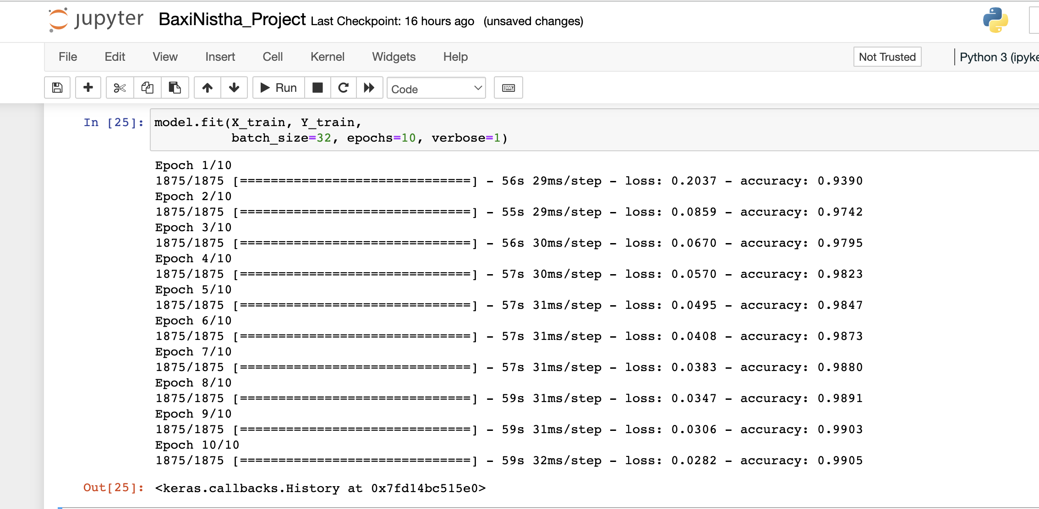
Train the Model
Batch_size: It is the number of images processed at once during the training. Ideal batch size is between 32 to 128
Epochs: Number of times we run the model; it learns better, hence increasing the accuracy.
Conclusion: Epoch 10 has the highest accuracy (99%) and lowest loss (0.02%). In simple words, it means that Epoch 10 predicted 99% of images correctly.

Slide 20
Questions??

Slide 21
References
https://elitedatascience.com/keras-tutorial-deep-learning-in-python
https://datascience.stackexchange.com/questions/44124/when-to-use-dense-conv1-2d-dropout-flatten-and-all-the-other-layers
https://www.simplilearn.com/tutorials/deep-learning-tutorial/what-is-deep-learning
https://www.tensorflow.org/datasets/catalog/mnist
https://keras.io/api/
https://www.baeldung.com/cs/convolutional-vs-regular-nn
https://www.analyticsvidhya.com/blog/2021/06/image-processing-using-cnn-a-beginners-guide/
https://www.expert.ai/blog/machine-learning-definition/
https://www.datacamp.com/tutorial/tutorial-deep-learning-tutorial
https://www.educative.io/blog/deep-learning-beginner-tutorial

